Slide 1
Introductory Session
Software Re-engineering
Haroon Zafar
Department of Computer Science,
National University of Computer and Emerging Sciences (NUCES), Peshawar Campus.

Slide 2
Introductory Session
Knowing each other
Some questions you need to answer
Be realistic

Slide 3
Introductory Session
Name
Belonging
CGPA
Area of expertise
Why BS(SE)

Slide 4



Introduction
Haroon Zafar
Lecturer
Department of Computer Science
National University of computer and emerging sciences
(NUCES).
Lecturer
Since Aug 2022-Aug 2023
Department of CS&IT
Sarhad University,
Peshawar, Pakistan
Lecturer
Feb 2021-Jul 2022
Faculty of Computing
Riphah International University,
Islamabad, Pakistan

Slide 5
Introduction (Cont…)
Industrial Experience
Data processing Officer
Pakistan Bureau of Statistics
Android Developer
Aksa-sds
Quest Lab (NUCES Islamabad)
Software Testing for CPS

Slide 6
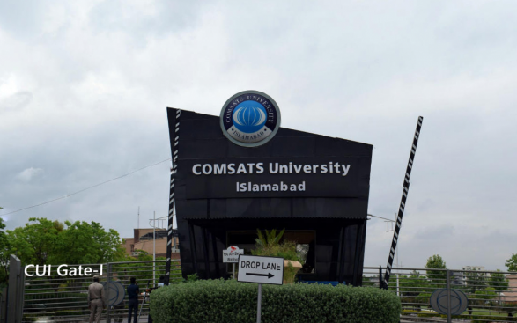
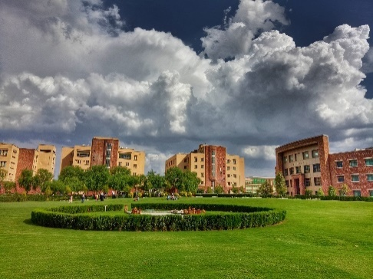
Education
Did my MS from COMSATS University Islamabad (CUI), Islamabad.
Educational back ground
MS(Software Engineering)
BS(Software Engineering)
Major Area Software Engineering

Slide 7
Personal Info
Contact
Office-19 (Academic Block)
Email:
haroon.zafar@nu.edu.pk

Slide 8
Batch Advisor
Batch Fall 2023 (SE/AI)

Slide 9
Course
Course title: Software Re-engineering
Instructor: Mr. Haroon Zafar
Credit Hours: 3
Semester: Spring 2024
Pre-requisite: Software Engineering

Slide 10

About this course
Core course for BS Software Engineering (SE) Program
The BS SE Program requires good understanding of software engineering practices and practical aspect of such practices
Design and Architectural understanding is required
Good programming skills are a must
Students should be familiar with modern programming concepts
(Until you learn)
(Complete BS degree)

Slide 11
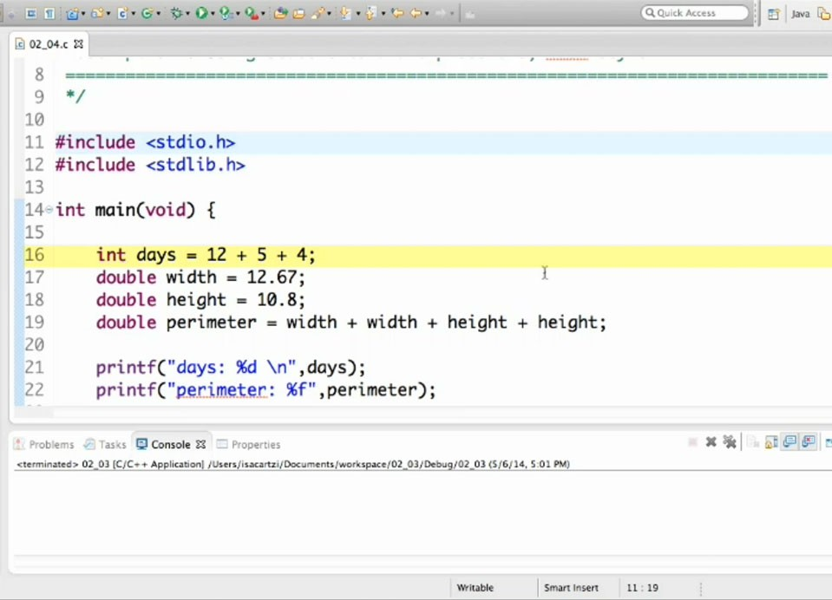

Alert
(This is a programming course)
(and YES Software Engineering requires good programming skills)

Slide 12
Table of Content (TOC)
All details available in Course Outline uploaded on Google Class room.

Slide 13
Course Structure
Course Work
Lectures
Assignments
Quizes
Project
Some real life application

Slide 14
Google classroom
Class Code
vs73n27

Slide 15
Recommended Books
Recommended Text Books:
Reengineering Software: How to Reuse Programming to Build New State-Of-Art software.

Slide 16
Final Words
A Right decision
You need to be specialist is some area of your study.
Programming
Web Development
Networking
Data bases etc
We need to be
Good CS Professional as well as
Good Human-being

Slide 17
THANKYOU!

